Slide 1
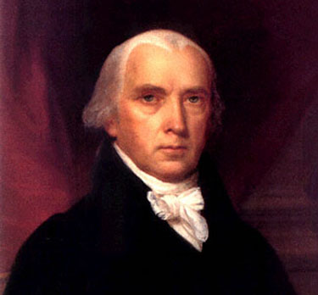
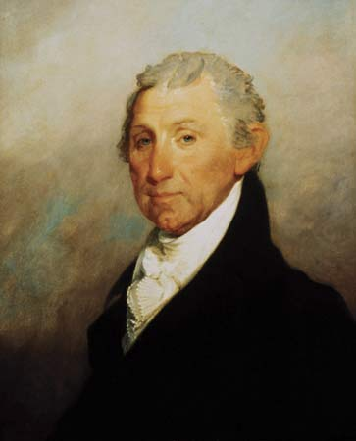
Chapter 12 The Second War for Independence and the Upsurge of Nationalism (1812-1824)
Telling the Story

Slide 2
Tell the Story of…
War of 1812 (Second War of Independence)
invasion of Canada
Oliver Hazard Perry
“We have met the enemy and they are ours.”
Burning of DC
Fort McHenry
Francis Scott Key
“The Star-Spangled Banner”
Battle of New Orleans
Andrew Jackson

Slide 3
Tell the Story of…
Federalists
Hartford Convention (1814)
secession
compensation for lost trade
2/3 vote for embargo
abolition of 3/5 clause
single-term presidency
end to the “Virginia dynasty”

Slide 4
Tell the Story of…
Treaty of Ghent (1814)
John Quincy Adams
Henry Clay
Rush-Bagot Agreement (1817)
Indians out of Ohio
stimulation of industry
nationalism
“Our country right or wrong.”
war heroes
James Monroe
“Era of Good Feelings”
demise of the Federalists
Washington Irving
James Fenimore Cooper

Slide 5
Tell the Story of…
British goods flood the market
Revised Bank of the U.S. (1816)
Tariff of 1816
Panic of 1819
over speculation on frontier land
“wildcat” banks
foreclosure

Slide 6
Tell the Story of…
transportation revolution
Cumberland Road (1811)
steamboats
Land Act of 1820
“internal improvements”
American System (1824)
Henry Clay

Slide 7
Tell the Story of…
Missouri
Tallmadge Amendment
“peculiar institution”
Henry Clay
Missouri Compromise (1820)
36 30’

Slide 8
Tell the Story of…
John Marshall
implied powers
judicial nationalism
McCulloch v. Maryland (1819)
Cohens v. Virginia (1821)
Gibbons v. Ogden (1824)

Slide 9
Tell the Story of…
John Marshall
Fletcher v. Peck (1810)
Dartmouth College v. Woodward (1819)
Daniel Webster
Hamiltonian ideas

Slide 10
Tell the Story of…
James Monroe
John Quincy Adams
Treaty of 1818
Andrew Jackson
Seminole Wars (1818)
Florida “Purchase “Treaty (1819)
Monroe Doctrine (1823)
Russo-American Treaty of 1824

